Slide 2
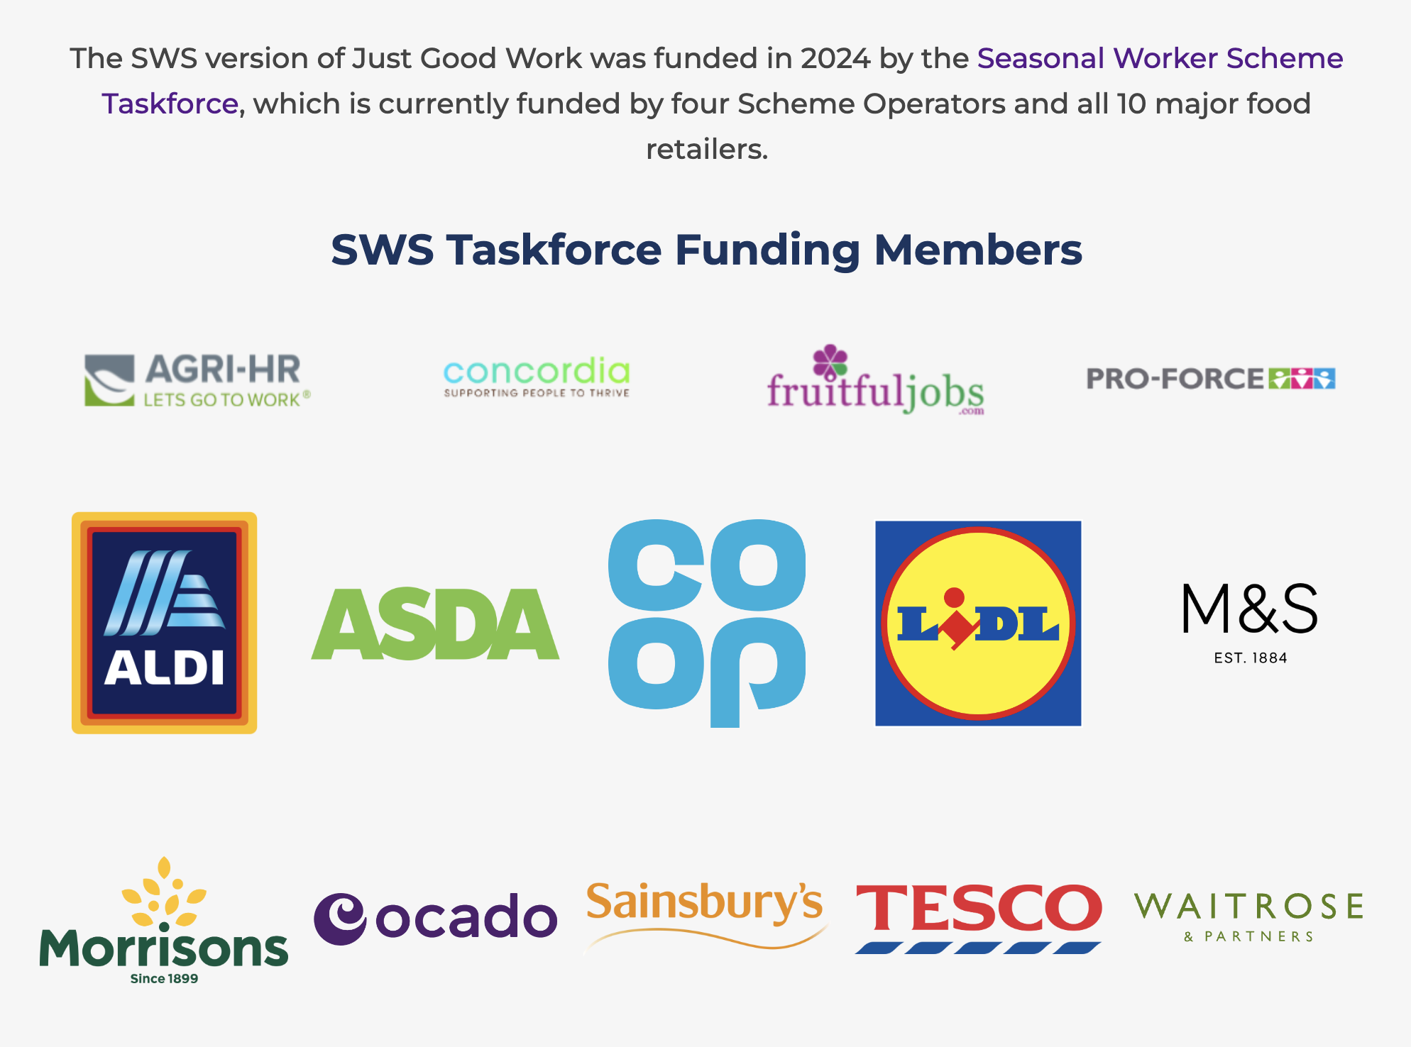
Just Good Work for SWS
The Just Good Work app provides clear advice and guidance for workers in their own language, helping protect workers from hidden exploitation risks during recruitment and on farm, and make sure they have a positive experience when working in UK agriculture and horticulture so that they wish to return next season.
10/21/2022
‹#›

Slide 3
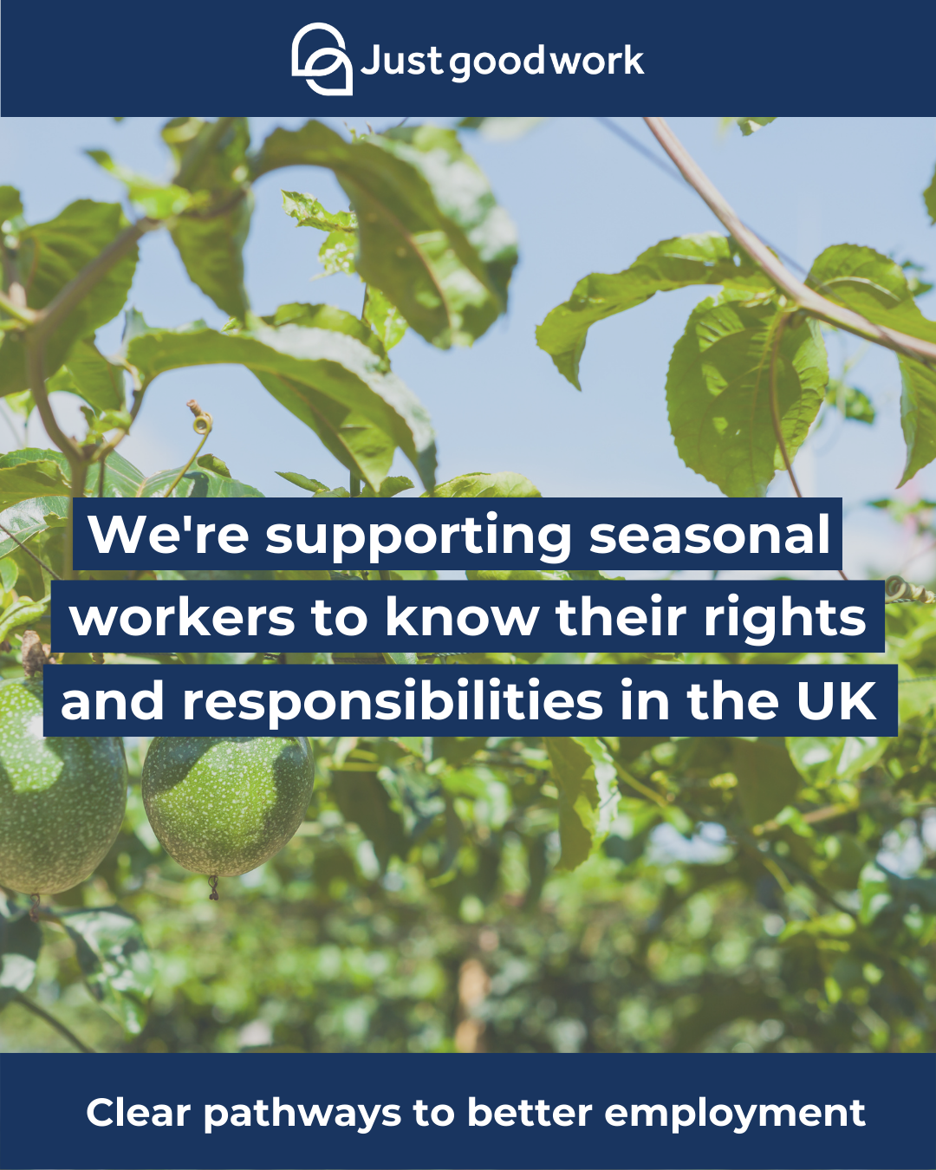
Post: Retailers, Operators, Suppliers
Suggested post text
We're partnering with Just Good Work: a free and independent mobile app that equips all UK workers with information and advice to ensure they enjoy safe and legal recruitment and employment in the UK
The app is available in:
English, Albanian, Bulgarian, Polish, Russian, Ukrainian, Romanian, Vietnamese, Bahasa Indonesian, Nepali
See more: http://sws.justgood.work/

Slide 4
Translations: Induction, emails etc.
Language | Text
English | Make sure you download the Just Good Work app and enter your My Work code to get information and regular updates on the Seasonal Worker Scheme.
Bulgarian | Уверете се, че сте свалили приложението Just Good Work и сте въвели кода My Work, за да получавате редовно обновявана информация за Схемата за сезонни работници.
Indonesian | Pastikan Anda mengunduh aplikasi Just Good Work dan memasukkan Pekerjaan Saya kode untuk mendapatkan informasi dan pembaruan reguler dalam Skema Pekerja Musiman.
Macedonian | Не заборавајте да ја преземете апликацијата Just Work Good и да го внесете Вашиот My Work код за да добивате информации и редовни известувања во врска со Програмата за сезонски работници.
Nepali | निश्चित गर्नुहोस् कि तपाईंले जष्ट गुड वर्क (Just Good Work) एप डाउनलोड गर्नुभयो र मौसमी कामदार योजनामा जानकारी र नियमित अपडेटहरू प्राप्त गर्न आफ्नो कार्य (My Work) कोड प्रविष्ट गर्नुभयो।
Polish | Koniecznie pobierz aplikację Just Good Work i wpisz swój kod My Work,aby otrzymywać informacje i regularne aktualizacje dotyczące Programu Pracowników Sezonowych.
Romanian | Nu uitați să descărcați aplicația Just Good Work și să vă introduceți codul My Work pentru a obține informații și actualizări periodice cu privire la Programul pentru lucrătorii sezonieri.
Russian | Скачайте приложение Just Good Work и не забудьте ввести ваш код My Work, чтобы получать информацию и регулярные обновления, касающиеся программы сезонных работников.
Serbian | Postarajte se da preuzmete aplikaciju Just Good Work i unesete svoj Moj posao kôd radi dobijanja informacija i redovnih ažuriranja o Sezonskom radnom aranžmanu.
Ukrainian | Завантажте застосунок Just Good Work і не забудьте ввести ваш код My Work, аби отримувати інформацію та регулярні оновлення щодо програми сезонних працівників.
Vietnamese | Hãy chắc rằng bạn đã tải xuống ứng dụng Just Good Work và nhập mã Công việc của tôi để được nhận thông tin và các cập nhật thường xuyên về Chương trình Người lao động theo Thời vụ.
The following pages (6-15) include translated work code instructions in this language order: English, Bulgarian, Polish, Romanian, Russian, Serbian, Ukrainian, Nepali, Vietnamese, Indonesian

Slide 5
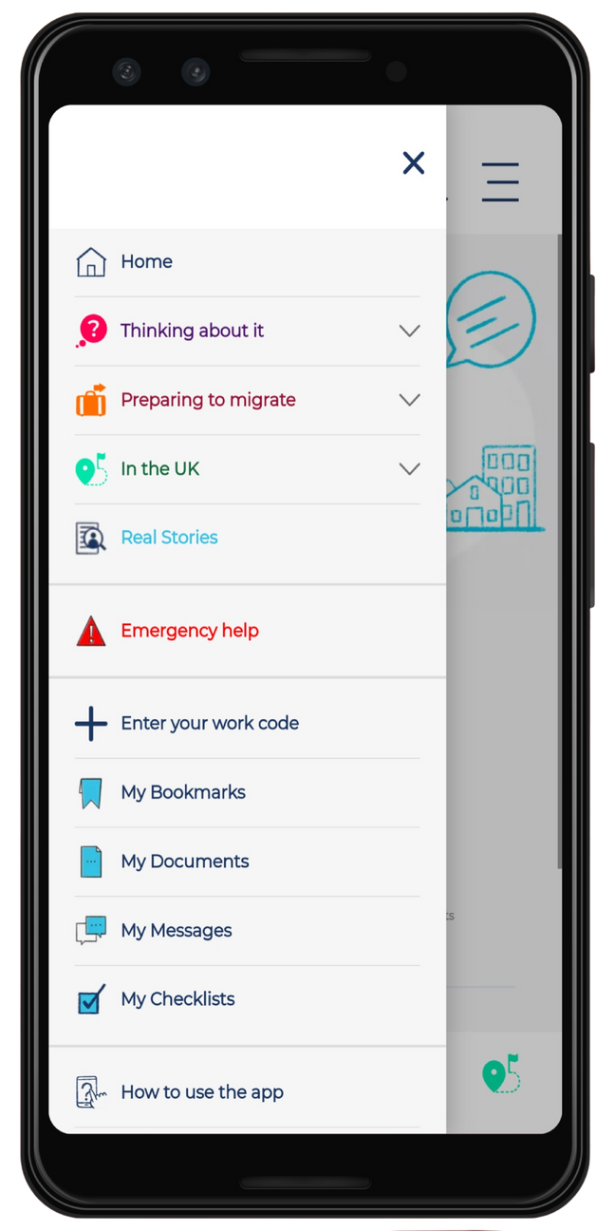
To get the latest information and regular updates on short term seasonal work in the UK, use the code you have been given by your sponsor or scheme operator.
If you haven't been given one you can use the code SWSG287 in the 'Enter your work code' section of the menu bar.
You can download the Just Good Work app here
sws.justgood.work

Slide 6
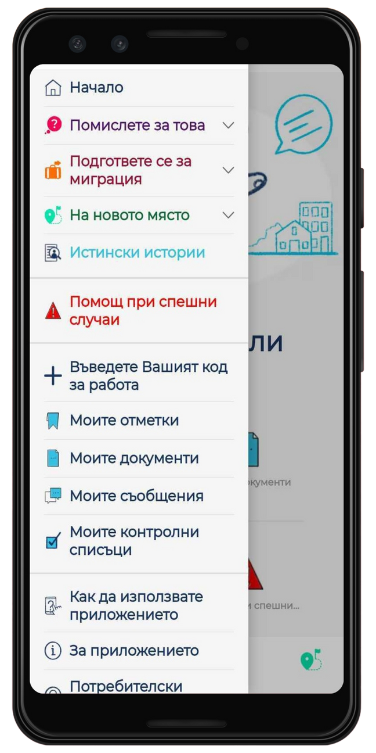
За да получите най-новата информация и регулярни актуализации относно краткосрочната сезонна заетост в Обединеното кралство, използвайте кода, който Ви е бил предоставен от Вашия спонсор или посредник за схемата.
Ако такъв не Ви е бил предоставен, може да използвате код SWSG287 в раздел Вписване на Менюто.
Може да изтеглите приложението Just Good Work оттук sws.justgood.work

Slide 7
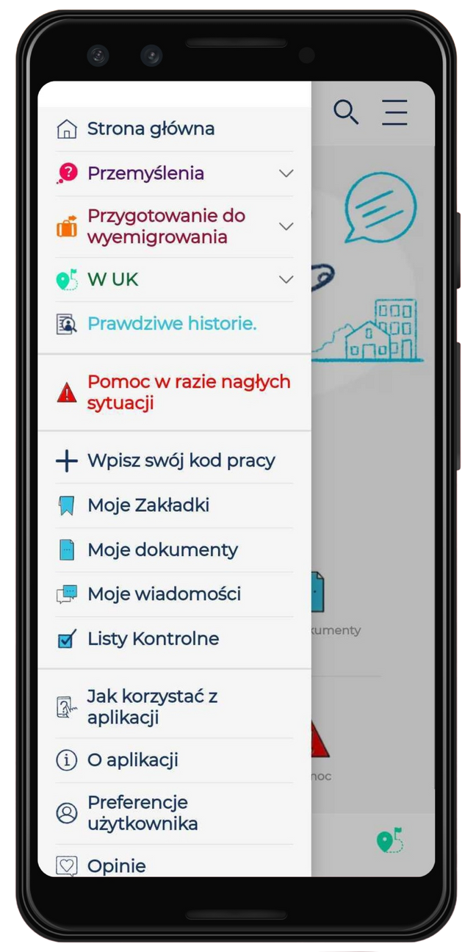
Aby uzyskać najnowsze informacje i regularne aktualizacje dotyczące krótkoterminowej pracy sezonowej w Zjednoczonym Królestwie, zastosuj kod otrzymany od sponsora lub administratora programu.
Jeśli nie otrzymałeś kodu, możesz użyć następującego kodu SWSG287 w sekcji `Zaloguj się` na pasku menu.
Aplikacja Just Good Work jest dostępna do pobrania tutaj
sws.justgood.work

Slide 8
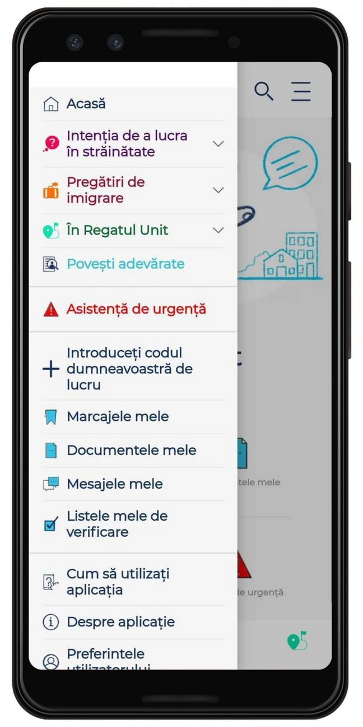
Pentru a obține cele mai recente informații și actualizări periodice privind munca sezonieră pe termen scurt în Marea Britanie, utilizați codul pe care vi l-a transmis sponsorul sau operatorul programului dvs.
Dacă nu ați primit unul, puteți folosi acest cod - SWSG287 în secțiunea Autentificare din bara de meniu.
Puteți descărca aici aplicația Just Good Work
sws.justgood.work

Slide 9
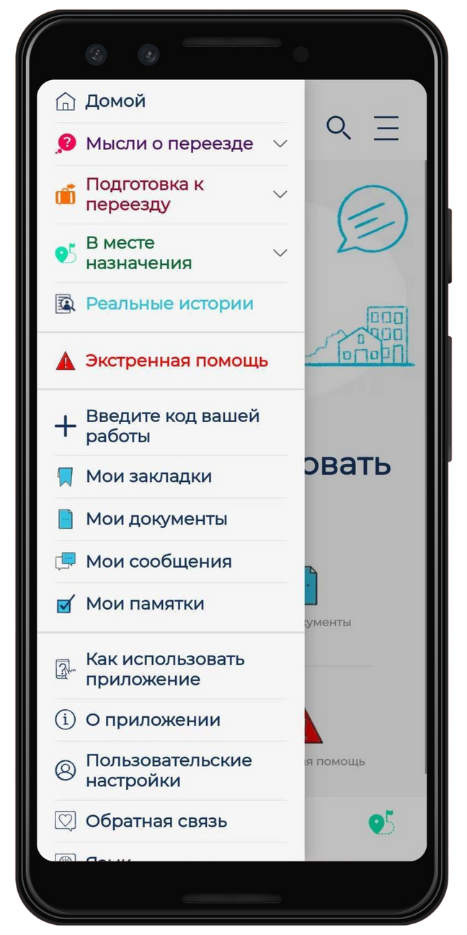
Чтобы получать последнюю информацию и регулярные обновления о краткосрочной сезонной работе в Соединенном Королевстве, используйте код, предоставленный вашим спонсором или оператором программы.
Если вам не предоставили код, вы можете ввести код SWSG287 в разделе Вход верхнего меню.
Скачать приложение Just Good Work можно по ссылке
sws.justgood.work

Slide 10
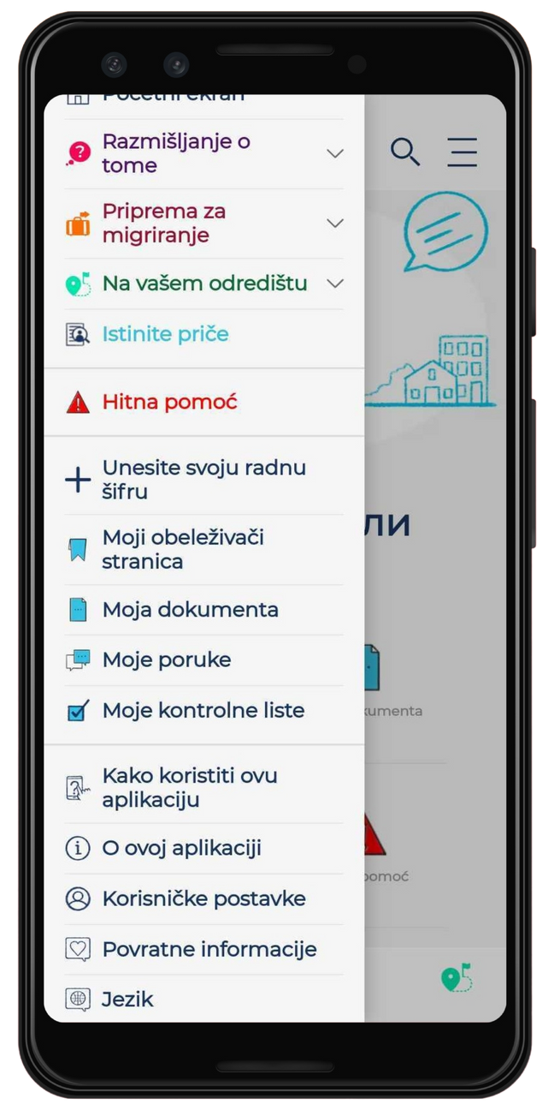
Kako biste dobili najnovije informacije i redovna ažuriranja o kratkoročnim sezonskim poslovima u UK (Ujedinjeno Kraljevstvo), iskoristite šifru koja vam bude data od strane vašeg sponzora ili operatera aranžmana.
Ukoliko vam ista ne bude data, možete koristiti sledeću šifru: SWSG287, u odeljku „Prijavite se“ na trake menija.
Aplikaciju Just Good Work možete preuzeti na
sws.justgood.work

Slide 11
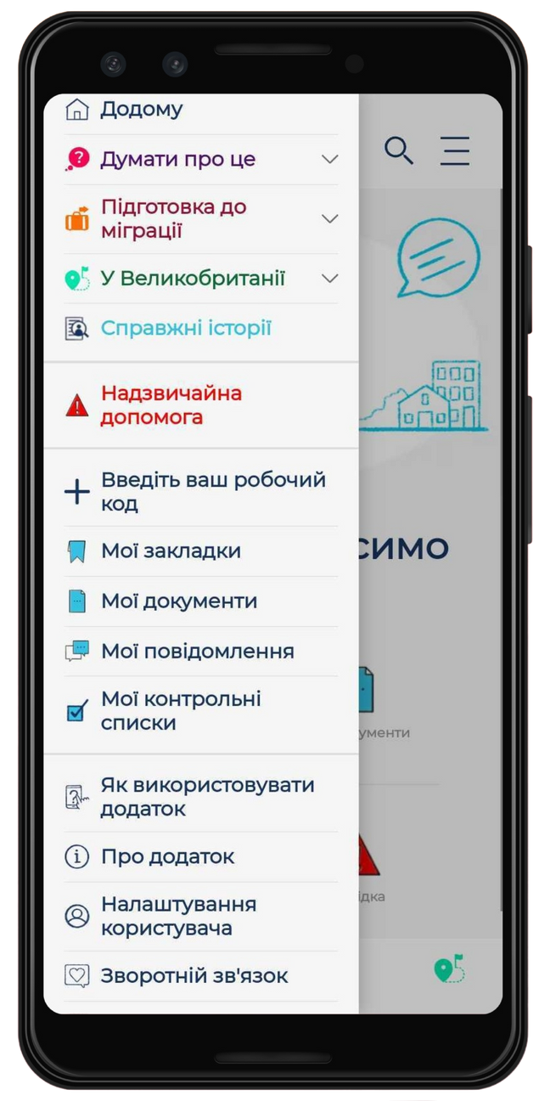
Щоб отримувати останню інформацію та регулярні оновлення, щодо короткострокової сезонної роботи у Великобританії, використовуйте код, який вам надав ваш спонсор або оператор програми.
Якщо ви його не отримали, ви можете використати код SWSG287 у розділі «Увійти» на панелі «Меню».
Завантажити додаток Just Good Work можна за посиланням
sws.justgood.work

Slide 12
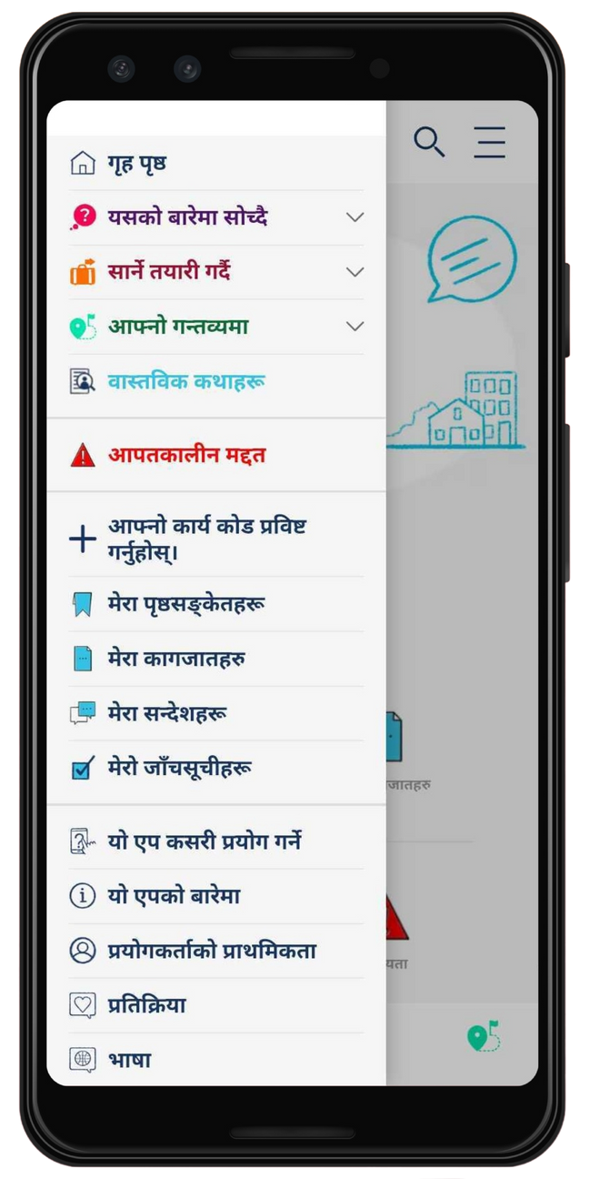
UK मा छोटो अवधिको मौसमी कामको बारेमा नवीनतम जानकारी र नियमित अपडेटहरू प्राप्त गर्न, तपाईको प्रायोजक वा योजना प्रचालकद्वारा दिइएको कोड प्रयोग गर्नुहोस्।
यदि तपाईलाई कोड दिइएको छैन भने,
तपाईले मेनु बार को साइन इन खण्डमा यो कोड SWSG287 प्रयोग गर्न सक्नुहुनेछ
तपाईले जस्ट गुड वर्क एप
sws.justgood.work

Slide 13
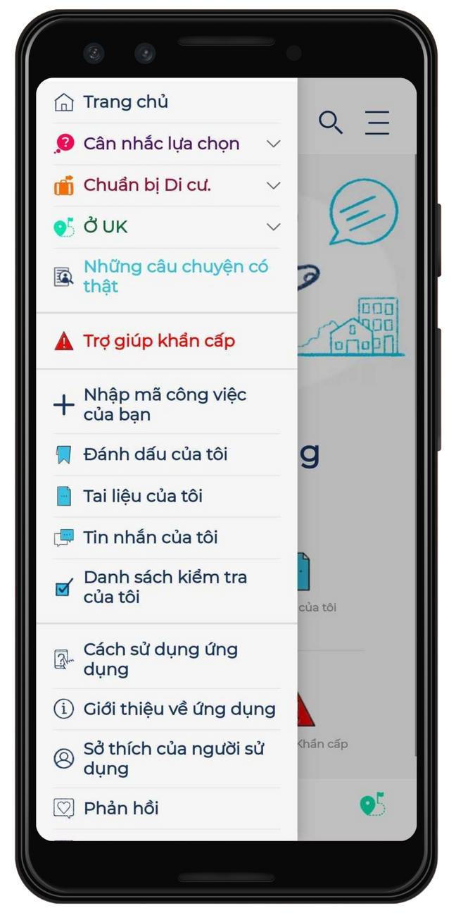
Để nhận được thông tin mới nhất và các cập nhật thường xuyên về công việc thời vụ ở nước Anh, hãy nhập mã do nhà tài trợ hoặc người điều hành chương trình cung cấp.
Nếu vẫn chưa nhận được mã, bạn có thể dùng mã SWSG287 trong mục Đăng nhập của thanh Menu.
Bạn có thể tải ứng dụng Just Good Work tại đây
sws.justgood.work

Slide 14
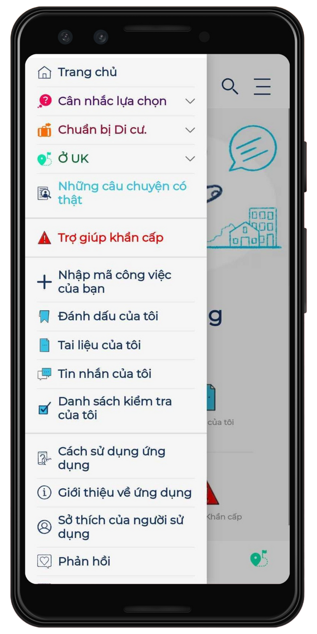
Untuk mendapatkan informasi terbaru dan pembaruan berkala tentang pekerjaan musiman jangka pendek di Britania Raya, gunakan kode yang telah diberikan oleh sponsor atau operator skema Anda.
Jika Anda belum mendapatkannya, Anda bisa menggunakan kode SWSG287 di bagian Masuk pada Menu bar.
Anda dapat mengunduh aplikasi Just Good Work di sini
sws.justgood.work

Slide 15
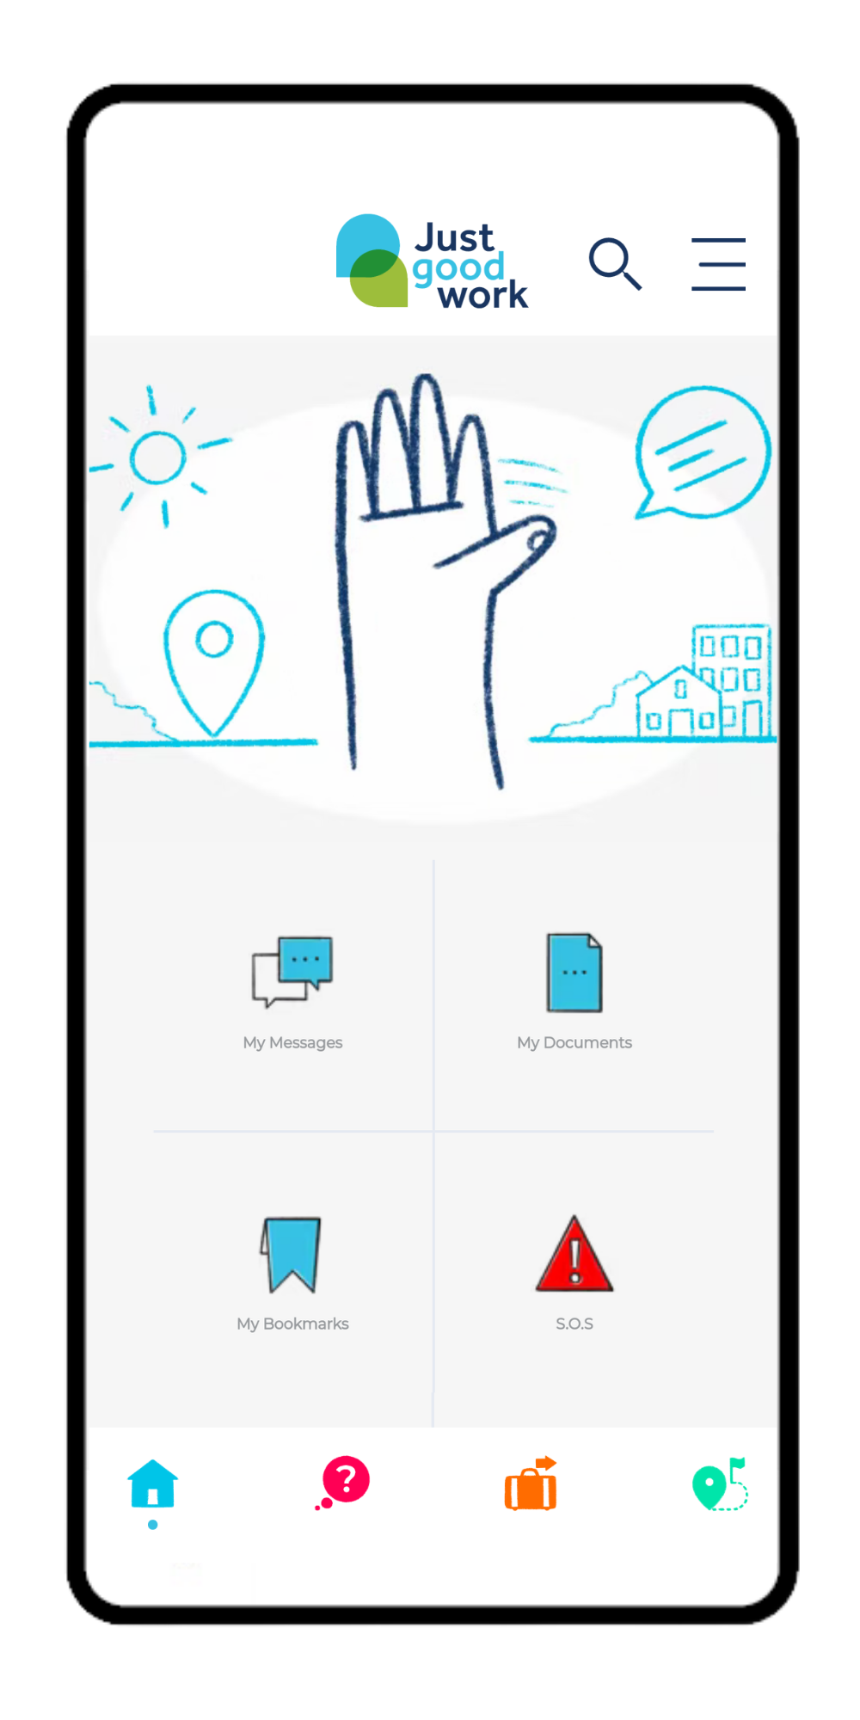
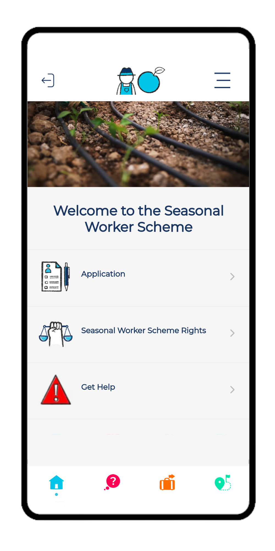
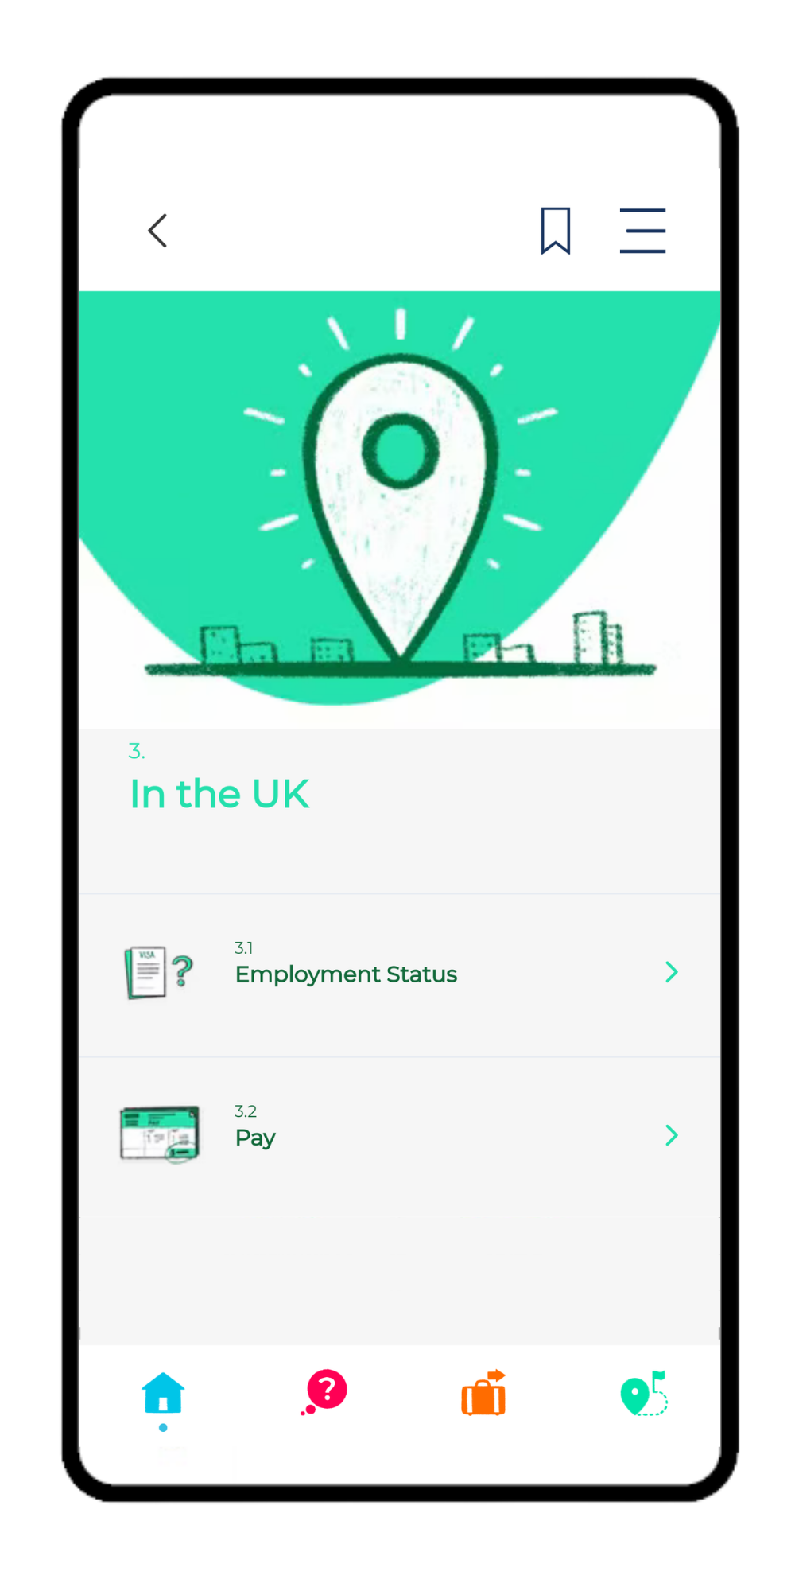
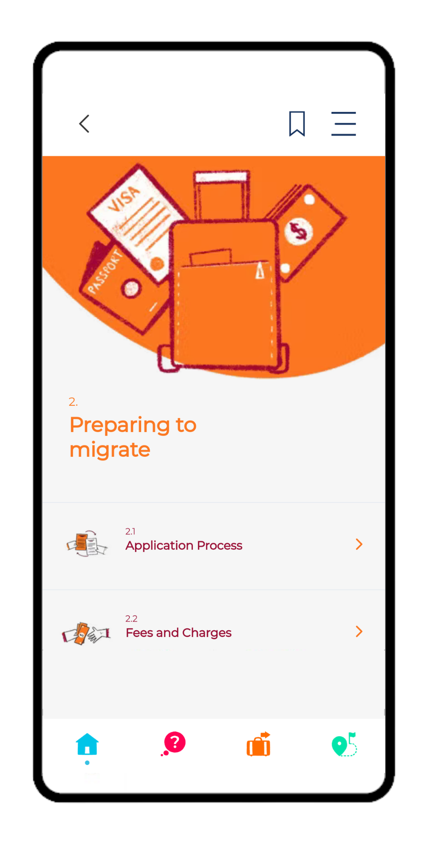
Screenshots

Slide 16
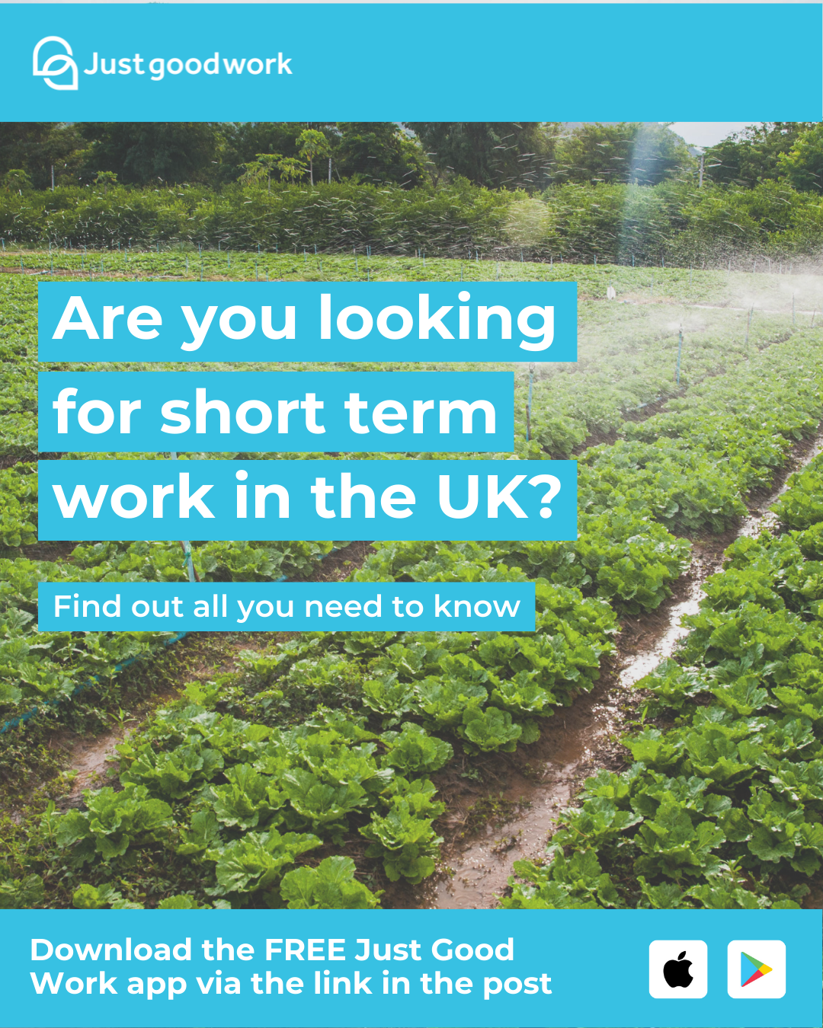
Post: Looking for Work
Suggested post text (translations on following slides)
Just Good Work is a free and independent mobile app created for those coming to or in the UK for work, with specific information on:
How to get seasonal work in the UK
Your rights in recruitment and at work
What life and work in the UK is like
Download using this link: http://sws.justgood.work/

Slide 17
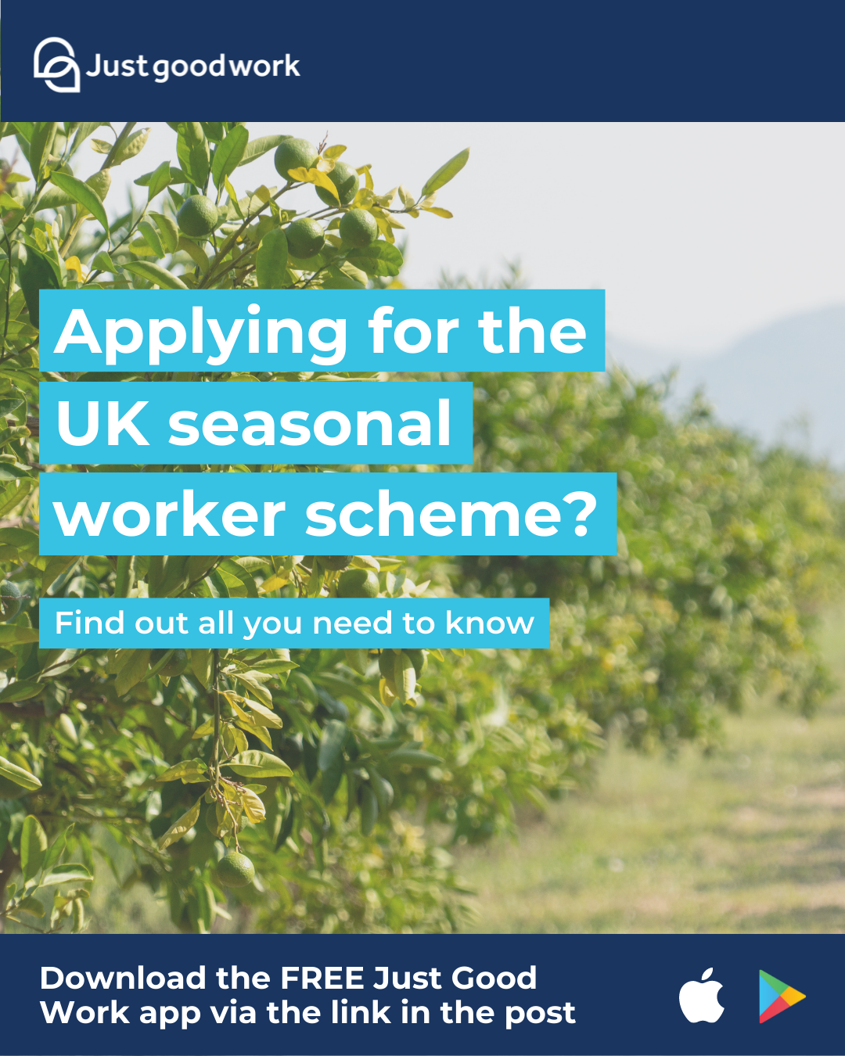
Post: Applying for Work
Suggested post text (translations on following slides)
Just Good Work is a free and independent mobile app created for those coming to or in the UK for work, with specific information on:
How to get seasonal work in the UK
Your rights in recruitment and at work
What life and work in the UK is like
Download using this link: http://sws.justgood.work/

Slide 18
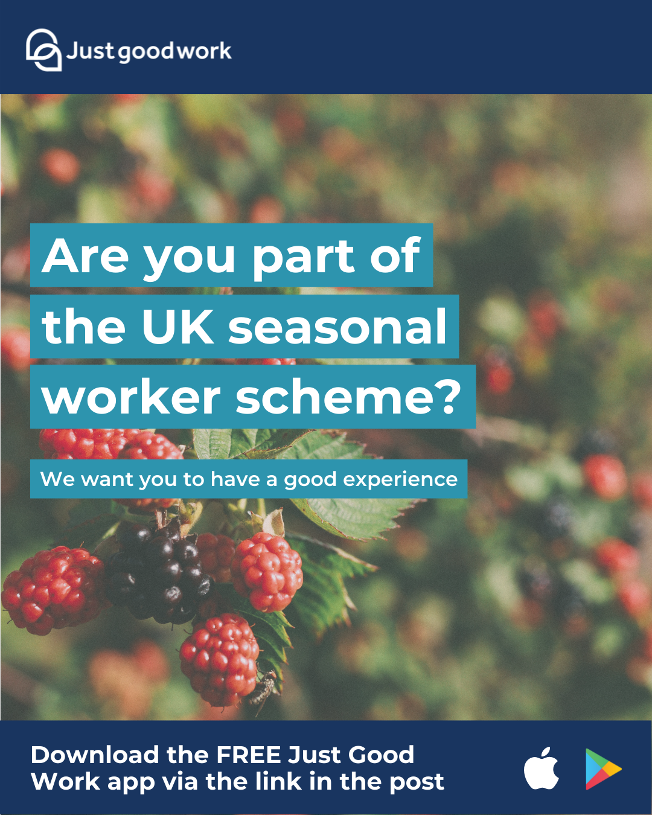
Post: On the scheme
Suggested post text (translations on following slides)
Just Good Work is a free and independent mobile app created for workers who are in UK for work, providing specific information and advice on:
Your rights in recruitment and at work
Information for life and work in the UK
How to get help and support if you have questions or problems
Download using this link: http://sws.justgood.work/

Slide 19
Suggested Post Text: Albanian
Language | Looking for Work | Part of the Seasonal Work Scheme | Make sure you download
English | Just Good Work is a free and independent mobile app created for those coming to or in the UK for work, with specific information on: * How to get seasonal work in the UK * Your rights in recruitment and at work *What life and work in the UK is like Download using this link: http://sws.justgood.work/ | Just Good Work is a free and independent mobile app created for workers who are in UK for work, providing specific information and advice on: * Your rights in recruitment and at work *Information for life and work in the UK * How to get help and support if you have questions or problems Download using this link: http://sws.justgood.work/ | Make sure you download the Just Good Work app and enter your My Work code to get information and regular updates on the Seasonal Worker Scheme. Download using this link: http://sws.justgood.work/
Albanian | Just Good Work është një aplikacion celular falas dhe i pavarur i krijuar për ata që vijnë në MB për punë, me informacion specifik mbi: * Si të merrni punë sezonale në MB * Të drejtat tuaja në rekrutim dhe në punë *Si është jeta dhe puna në UK Shkarkoni me këtë link: http://sws.justgood.work/ | Just Good Work është një aplikacion celular falas dhe i pavarur i krijuar për ata që vijnë MB për punë, me informacion specifik mbi: * Të drejtat tuaja në rekrutim dhe në punë Njihni të drejtat e juaja për jetën dhe punën në MB Si të merrni ndihmë dhe mbështetje nëse keni pyetje ose probleme Shkarkoni me këtë link: http://sws.justgood.work/ | Sigurohuni që të shkarkoni aplikacionin Just Good Work dhe të futni kodin tuajPuna Imepër të marrë informacione dhe përditësime të rregullta mbi Skemën e Punëtorëve Sezonalë. Shkarkoni me këtë link: http://sws.justgood.work/

Slide 20
Suggested Post Text: Bulgarian
Language | Looking for Work | Part of the Seasonal Work Scheme | Make sure you download
English | Just Good Work is a free and independent mobile app created for those coming to or in the UK for work, with specific information on: * How to get seasonal work in the UK * Your rights in recruitment and at work *What life and work in the UK is like Download using this link: http://sws.justgood.work/ | Just Good Work is a free and independent mobile app created for workers who are in UK for work, providing specific information and advice on: * Your rights in recruitment and at work *Information for life and work in the UK * How to get help and support if you have questions or problems Download using this link: http://sws.justgood.work/ | Make sure you download the Just Good Work app and enter your My Work code to get information and regular updates on the Seasonal Worker Scheme. Download using this link: http://sws.justgood.work/
Bulgarian | Just Good Work е безплатно и независимо мобилно приложение, създадено за тези, които идват или се намират в Обединеното кралство за работа, с конкретна информация за: * Как да намерите сезонна работа в Обединеното кралство * Правата ви при наемане на работа и на работното място *Какъв е животът и работата в Обединеното кралство Изтеглете от този линк http://sws.justgood.work/ | Just Good Work е безплатно и независимо мобилно приложение, създадено за тези, които са в Обединеното кралство за работа, с конкретна информация и съвети за: * Правата ви при наемане на работа и на работното място *Живота и работата в Обединеното кралство * Как да получите помощ и подкрепа, ако имате въпроси или проблеми Изтеглете от този линк http://sws.justgood.work/ | Уверете се, че сте свалили приложението Just Good Work и сте въвели кода My Work, за да получавате редовно обновявана информация за Схемата за сезонни работници. Изтеглете от този линк http://sws.justgood.work/

Slide 21
Suggested Post Text: Indonesian
Language | Looking for Work | Part of the Seasonal Work Scheme | Make sure you download
English | Just Good Work is a free and independent mobile app created for those coming to or in the UK for work, with specific information on: * How to get seasonal work in the UK * Your rights in recruitment and at work *What life and work in the UK is like Download using this link: http://sws.justgood.work/ | Just Good Work is a free and independent mobile app created for workers who are in UK for work, providing specific information and advice on: * Your rights in recruitment and at work *Information for life and work in the UK * How to get help and support if you have questions or problems Download using this link: http://sws.justgood.work/ | Make sure you download the Just Good Work app and enter your My Work code to get information and regular updates on the Seasonal Worker Scheme. Download using this link: http://sws.justgood.work/
Indonesian | Just Good Work adalah aplikasi seluler gratis dan independen yang dirancang untuk orang yang datang untuk bekerja di atau ke Inggris dengan informasi spesifik mengenai: * Cara mendapatkan pekerjaan musiman di Inggris * Hak Anda dalam perekrutan dan di tempat kerja * Gambaran kehidupan dan pekerjaan di Inggris Unduh menggunakan tautan berikut ini http://sws.justgood.work/ | Just Good Work adalah aplikasi seluler gratis dan independen yang dirancang untuk para pekerja yang bekerja di Inggris, menyediakan informasi spesifik dan saran mengenai: * Hak Anda dalam perekrutan dan di tempat kerja * Informasi mengenai kehidupan dan pekerjaan di Inggris * Cara mendapatkan bantuan dan dukungan jika Anda mempunyai pertanyaan atau masalah Unduh menggunakan tautan berikut ini http://sws.justgood.work/ | Pastikan Anda mengunduh aplikasi Just Good Work dan memasukkan Pekerjaan Saya kode untuk mendapatkan informasi dan pembaruan reguler dalam Skema Pekerja Musiman. Unduh menggunakan tautan berikut ini http://sws.justgood.work/

Slide 22
Suggested Post Text: Macedonian
Language | Looking for Work | Part of the Seasonal Work Scheme | Make sure you download
English | Just Good Work is a free and independent mobile app created for those coming to or in the UK for work, with specific information on: * How to get seasonal work in the UK * Your rights in recruitment and at work *What life and work in the UK is like Download using this link: http://sws.justgood.work/ | Just Good Work is a free and independent mobile app created for workers who are in UK for work, providing specific information and advice on: * Your rights in recruitment and at work *Information for life and work in the UK * How to get help and support if you have questions or problems Download using this link: http://sws.justgood.work/ | Make sure you download the Just Good Work app and enter your My Work code to get information and regular updates on the Seasonal Worker Scheme. Download using this link: http://sws.justgood.work/
Macedonian | Just Good Work е бесплатна и независна мобилна апликација креирана за оние што доаѓаат или престојуваат во Обединетото Кралство на работа, со конкретни информации за: * Како да најдете сезонска работа во Обединетото Кралство * Вашите права при регрутирање и на работното место *Како изгледаат животот и работата во Обединетото Кралство Преземете ја преку следниот линк http://sws.justgood.work/ | Just Good Work е бесплатна и независна мобилна апликација креирана за работници што престојуваат во Обединетото Кралство на работа, која обезбедува конкретни информации и совети за: * Вашите права при регрутирање и на работното место *Информации за животот и работата во Обединетото Кралство * Како да добиете помош или поддршка доколку имате прашања или проблеми Преземете ја преку следниот линк http://sws.justgood.work/ | Не заборавајте да ја преземете апликацијата Just Work Good и да го внесете Вашиот My Work код за да добивате информации и редовни известувања во врска со Програмата за сезонски работници. Преземете ја преку следниот линк http://sws.justgood.work/

Slide 23
Suggested Post Text: Nepali
Language | Looking for Work | Part of the Seasonal Work Scheme | Make sure you download
English | Just Good Work is a free and independent mobile app created for those coming to or in the UK for work, with specific information on: * How to get seasonal work in the UK * Your rights in recruitment and at work *What life and work in the UK is like Download using this link: http://sws.justgood.work/ | Just Good Work is a free and independent mobile app created for workers who are in UK for work, providing specific information and advice on: * Your rights in recruitment and at work *Information for life and work in the UK * How to get help and support if you have questions or problems Download using this link: http://sws.justgood.work/ | Make sure you download the Just Good Work app and enter your My Work code to get information and regular updates on the Seasonal Worker Scheme. Download using this link: http://sws.justgood.work/
Nepali | जस्ट गुड वर्क एउटा नि:शुल्क र स्वतन्त्र मोबाइल एप हो जसमा विशेष जानकारी सहित कामको लागि यूकेमा आउने वा आउनेहरूका लागि बनाइएको छ। *UK मा मौसमी काम कसरी प्राप्त गर्ने *भर्ती र काममा तपाईंको अधिकार *UK मा जीवन र काम कस्तो छ यो लिङ्क प्रयोग गरेर डाउनलोड गर्नुहोस्। http://sws.justgood.work/ | जस्ट गुड वर्क एउटा नि:शुल्क र स्वतन्त्र मोबाइल एप हो जसमा विशेष जानकारी सहित कामको लागि UKमा आउने वा आउनेहरूका लागि बनाइएको छ। *भर्ती र काममा तपाईंको अधिकार *UK मा जीवन र कामबारे जानकारी * यदि तपाइँसँग प्रश्न वा समस्या छ भने मद्दत र सहयोग कसरी प्राप्त गर्ने यो लिङ्क प्रयोग गरेर डाउनलोड गर्नुहोस्। http://sws.justgood.work/ | निश्चित गर्नुहोस् कि तपाईंले जष्ट गुड वर्क (Just Good Work) एप डाउनलोड गर्नुभयो र मौसमी कामदार योजनामा जानकारी र नियमित अपडेटहरू प्राप्त गर्न आफ्नो कार्य (My Work) कोड प्रविष्ट गर्नुभयो। यो लिङ्क प्रयोग गरेर डाउनलोड गर्नुहोस्। http://sws.justgood.work/

Slide 24
Suggested Post Text: Polish
Language | Looking for Work | Part of the Seasonal Work Scheme | Make sure you download
English | Just Good Work is a free and independent mobile app created for those coming to or in the UK for work, with specific information on: * How to get seasonal work in the UK * Your rights in recruitment and at work *What life and work in the UK is like Download using this link: http://sws.justgood.work/ | Just Good Work is a free and independent mobile app created for workers who are in UK for work, providing specific information and advice on: * Your rights in recruitment and at work *Information for life and work in the UK * How to get help and support if you have questions or problems Download using this link: http://sws.justgood.work/ | Make sure you download the Just Good Work app and enter your My Work code to get information and regular updates on the Seasonal Worker Scheme. Download using this link: http://sws.justgood.work/
Polish | Just Good Work jest darmową i niezależną aplikacją stworzoną dla przyjeżdżających do Wielkiej Brytanii do pracy oraz osób już tam przebywających, z informacjami o: * Sposobie uzyskania pracy sezonowej w Wielkiej Brytanii * Twoich prawach w trakcie rekrutacji i pracy *Życiu i pracy w Wielkiej Brytanii Pobierz z pomocą tego łącza http://sws.justgood.work/ | Just Good Work jest darmową i niezależną aplikacją stworzoną dla pracowników w Wielkiej Brytanii, z konkretnymi informacjami o: * Twoich prawach w trakcie rekrutacji i pracy *Życiu i pracy w Wielkiej Brytanii * Sposobach na uzyskanie pomocy i wsparcia w przypadku pytań lub problemów Pobierz z pomocą tego łącza http://sws.justgood.work/ | Koniecznie pobierz aplikację Just Good Work i wpisz swój kod My Work,aby otrzymywać informacje i regularne aktualizacje dotyczące Programu Pracowników Sezonowych. Pobierz z pomocą tego łącza http://sws.justgood.work/

Slide 25
Suggested Post Text: Romanian
Language | Looking for Work | Part of the Seasonal Work Scheme | Make sure you download
English | Just Good Work is a free and independent mobile app created for those coming to or in the UK for work, with specific information on: * How to get seasonal work in the UK * Your rights in recruitment and at work *What life and work in the UK is like Download using this link: http://sws.justgood.work/ | Just Good Work is a free and independent mobile app created for workers who are in UK for work, providing specific information and advice on: * Your rights in recruitment and at work *Information for life and work in the UK * How to get help and support if you have questions or problems Download using this link: http://sws.justgood.work/ | Make sure you download the Just Good Work app and enter your My Work code to get information and regular updates on the Seasonal Worker Scheme. Download using this link: http://sws.justgood.work/
Romanian | Just Good Work este o aplicație mobilă gratuită și independentă creată pentru cei care vin sau se află în Regatul Unit pentru un loc de muncă, cu informații specifice despre: * Cum să obțineți un loc de muncă sezonier în Regatul Unit * Drepturile dumneavoastră la recrutare și la locul de muncă * Cum e să trăiești și să lucrezi în Regatul Unit Descărcați-o folosind acest link http://sws.justgood.work/ | Just Good Work este o aplicație mobilă gratuită și independentă, creată pentru lucrătorii care se află în Regatul Unit pentru un loc de muncă, care oferă informații și sfaturi specifice privind: * Drepturile dumneavoastră la recrutare și la locul de muncă * Informații despre traiul și munca în Regatul Unit * Cum să obțineți asistență și sprijin în cazul în care aveți întrebări sau probleme Descărcați-o folosind acest link http://sws.justgood.work/ | Nu uitați să descărcați aplicația Just Good Work și să vă introduceți codul My Work pentru a obține informații și actualizări periodice cu privire la Programul pentru lucrătorii sezonieri. Descărcați-o folosind acest link http://sws.justgood.work/

Slide 26
Suggested Post Text: Russian
Language | Looking for Work | Part of the Seasonal Work Scheme | Make sure you download
English | Just Good Work is a free and independent mobile app created for those coming to or in the UK for work, with specific information on: * How to get seasonal work in the UK * Your rights in recruitment and at work *What life and work in the UK is like Download using this link: http://sws.justgood.work/ | Just Good Work is a free and independent mobile app created for workers who are in UK for work, providing specific information and advice on: * Your rights in recruitment and at work *Information for life and work in the UK * How to get help and support if you have questions or problems Download using this link: http://sws.justgood.work/ | Make sure you download the Just Good Work app and enter your My Work code to get information and regular updates on the Seasonal Worker Scheme. Download using this link: http://sws.justgood.work/
Russian | Just Good Work — это бесплатное и независимое мобильное приложение для жителей Великобритании и тех, кто приезжает сюда на работу, с подробной информацией на следующие темы: * Как найти сезонную работу в Британии * Какие у вас права как у кандидата и работника *Что нужно знать про жизнь и работу в Британии Скачивайте по ссылке http://sws.justgood.work/ | Just Good Work — это бесплатное и независимое мобильное приложение для жителей Великобритании и тех, кто приезжает сюда на работу, с подробной информацией на следующие темы: * Какие у вас права как у кандидата и работника *Что нужно знать про жизнь и работу в Британии * Как получить помощь и поддержку, если у вас есть вопросы или вы столкнулись с трудностями Скачивайте по ссылке http://sws.justgood.work/ | Скачайте приложение Just Good Work и не забудьте ввести ваш код My Work, чтобы получать информацию и регулярные обновления, касающиеся программы сезонных работников. Скачивайте по ссылке http://sws.justgood.work/

Slide 27
Suggested Post Text: Serbian
Language | Looking for Work | Part of the Seasonal Work Scheme | Make sure you download
English | Just Good Work is a free and independent mobile app created for those coming to or in the UK for work, with specific information on: * How to get seasonal work in the UK * Your rights in recruitment and at work *What life and work in the UK is like Download using this link: http://sws.justgood.work/ | Just Good Work is a free and independent mobile app created for workers who are in UK for work, providing specific information and advice on: * Your rights in recruitment and at work *Information for life and work in the UK * How to get help and support if you have questions or problems Download using this link: http://sws.justgood.work/ | Make sure you download the Just Good Work app and enter your My Work code to get information and regular updates on the Seasonal Worker Scheme. Download using this link: http://sws.justgood.work/
Serbian | Just Good Work je besplatna i nezavisna aplikacija za mobilne telefone kreirana za one koji dolaze u UK ili iz unutrašnjosti na rad, s konkretnim podacima o: * Kako dobiti sezonski posao u UK * Vašim pravima prilikom angažovanja i na poslu *Kako izgleda život i rad u UK Preuzmite koristeći ovu vezu http://sws.justgood.work/ | Just Good Work je besplatna i nezavisna aplikacija za mobilne telefone kreirana za radnike na radnom boravku u UK, koja pruža konkretne podatke i savete o sledećem: * Vašim pravima prilikom angažovanja i na poslu *Informacijama za život i rad u UK * Kako da dobijete pomoć i podršku, ako imate neka pitanja ili probleme Preuzmite koristeći ovu vezu http://sws.justgood.work/ | Postarajte se da preuzmete aplikaciju Just Good Work i unesete svoj Moj posao kôd radi dobijanja informacija i redovnih ažuriranja o Sezonskom radnom aranžmanu. Preuzmite koristeći ovu vezu http://sws.justgood.work/

Slide 28
Suggested Post Text: Ukrainian
Language | Looking for Work | Part of the Seasonal Work Scheme | Make sure you download
English | Just Good Work is a free and independent mobile app created for those coming to or in the UK for work, with specific information on: * How to get seasonal work in the UK * Your rights in recruitment and at work *What life and work in the UK is like Download using this link: http://sws.justgood.work/ | Just Good Work is a free and independent mobile app created for workers who are in UK for work, providing specific information and advice on: * Your rights in recruitment and at work *Information for life and work in the UK * How to get help and support if you have questions or problems Download using this link: http://sws.justgood.work/ | Make sure you download the Just Good Work app and enter your My Work code to get information and regular updates on the Seasonal Worker Scheme. Download using this link: http://sws.justgood.work/
Ukrainian | Just Good Work — безкоштовний та незалежний застосунок для тих, хто приїжджає на роботу до Британії або живе у Британії. Завдяки йому ви дізнаєтеся: * Як отримати сезонну роботу в Британії * Які ваші права як кандидата і працівника *Як у Британії влаштовані робота і життя Завантажуйте за посиланням http://sws.justgood.work/ | Just Good Work — безкоштовний та незалежний застосунок для тих, хто працює в Британії. Він надає конкретну інформацію і поради: * Які ваші права як кандидата і працівника *Що варто знати про життя та роботу в Британії * Де отримати допомогу та підтримку, якщо ви маєте запитання або зіткнулися з труднощами Завантажуйте за посиланням http://sws.justgood.work/ | Завантажте застосунок Just Good Work і не забудьте ввести ваш код My Work, аби отримувати інформацію та регулярні оновлення щодо програми сезонних працівників. Завантажуйте за посиланням http://sws.justgood.work/

Slide 29
Suggested Post Text: Vietnamese
Language | Looking for Work | Part of the Seasonal Work Scheme | Make sure you download
English | Just Good Work is a free and independent mobile app created for those coming to or in the UK for work, with specific information on: * How to get seasonal work in the UK * Your rights in recruitment and at work *What life and work in the UK is like Download using this link: http://sws.justgood.work/ | Just Good Work is a free and independent mobile app created for workers who are in UK for work, providing specific information and advice on: * Your rights in recruitment and at work *Information for life and work in the UK * How to get help and support if you have questions or problems Download using this link: http://sws.justgood.work/ | Make sure you download the Just Good Work app and enter your My Work code to get information and regular updates on the Seasonal Worker Scheme. Download using this link: http://sws.justgood.work/
Vietnamese | Just Good Work là một ứng dụng di động độc lập và miễn phí, được tạo ra dành cho những người đến từ hoặc đi đến Vương quốc Anh để làm việc, cung cấp các thông tin cụ thể về: * Cách để có được công việc thời vụ tại Vương quốc Anh * Quyền của bạn trong vấn đề tuyển dụng và tại nơi làm việc *Việc sinh sống và làm việc tại Anh sẽ như thế nào Tải về bằng đường link này http://sws.justgood.work/ | Just Good Work là một ứng dụng di động độc lập và miễn phí, được tạo ra dành cho những người lao động đến Vương quốc Anh để làm việc, cung cấp các thông tin và lời khuyên cụ thể về: * Quyền của bạn trong vấn đề tuyển dụng và tại nơi làm việc *Thông tin về cuộc sống và làm việc tại Anh * Cách để nhận giúp đỡ và hỗ trợ khi bạn có thắc mắc hoặc gặp vấn đề Tải về bằng đường link này http://sws.justgood.work/ | Hãy chắc rằng bạn đã tải xuống ứng dụng Just Good Work và nhập mã Công việc của tôi để được nhận thông tin và các cập nhật thường xuyên về Chương trình Người lao động theo Thời vụ. Tải về bằng đường link này http://sws.justgood.work/

